Slide 1
Predictive Analytics for Customer Churn
Analytics Project Using Python
Student Name: NAMAN SINGH CHAUHAN
Roll No: 2501921570082

Slide 2


DEFINING CUSTOMER CHURN
What is Churn?
The Business Impact
Customer churn, or attrition, is the rate at which customers stop doing business with an entity. In the subscription economy, it is the primary metric for tracking long-term viability.
Churn is a critical business problem because losing a customer results in lost revenue and increases the pressure on acquisition teams to find new users to maintain growth.
"Acquiring a new customer is 5 to 25 times more expensive than retaining an existing one." — Harvard Business Review

Slide 3
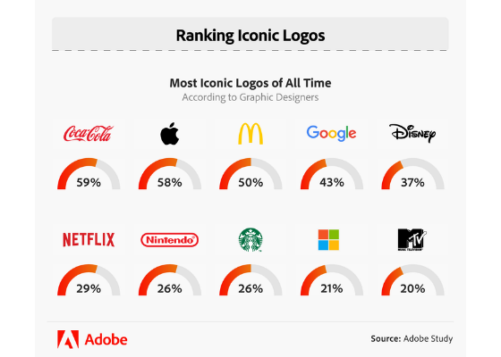

MARKET CONTEXT & EXAMPLES
Industries at Risk
High-frequency transaction industries are most affected:
Telecom (Airtel/Jio) Switching costs are low; network quality is key.
SaaS & Streaming (Netflix) Content fatigue leads to immediate cancellation.
E-commerce Loyalty is often driven by price and delivery speed.

Slide 4

THE RESEARCH CHALLENGE
Research Question Which specific customer segments are most likely to churn in the next 30 days?
The Problem Statement
Despite a growing user base, the company is seeing a consistent 5% monthly attrition. We need to shift from reactive support to proactive retention using predictive modeling.
Strategic Objectives
Identify Key Churn Drivers: Uncover the specific pain points—such as contract types, high monthly charges, or lack of technical support—that lead customers to leave.
Predictive Risk Modeling: Develop a machine learning framework to assign a Churn Probability Score to every customer, allowing for early intervention before a cancellation occurs.
Data-Driven Retention: Recommend targeted business strategies (e.g., loyalty incentives for high-risk segments) to improve customer lifetime value (CLV).

Slide 5
MEASURING SUCCESS
KPI | Value | Business Interpretation
Overall Churn Rate | 26.54% | Roughly 1 in 4 customers leave; indicates a high-risk environment.
Retention Rate | 73.46% | The baseline stability of the existing customer base.
Average CLV | $2,283 | The projected total revenue per customer over their lifespan.
At-Risk MRR | $139,130 | The Monthly Recurring Revenue lost due to the churned segment.
Project Scope
The project is based on a static historical snapshot (IBM Telco Dataset) and focuses solely on internal first-party structured data such as billing, services, and demographics, excluding real-time streams, external market factors, and qualitative customer feedback. It emphasizes quantitative analysis of structured variables to generate precise, actionable insights within clearly defined boundaries.
Baseline Metrics (The Raw Numbers)
Total Customers: $7,043
Churned Customers: $1,869
Average Monthly Charge: $64.76
Average Tenure: $32.4 months

Slide 6
The 6-Stage Methodology
Problem Definition:
Identifying high churn (26.5%) as the primary threat to revenue.
Defining the goal: Predicting individual churn probability to enable proactive retention.
Data Collection:
Sourcing the IBM Telco "Gold Standard" dataset.
Integrating 21 features spanning demographics, account info, and services.
Data Cleaning:
The Critical Fix: Converting Total Charges from string to numeric.
Handling null values (11 rows) and encoding categorical text (e.g., "Yes/No" to 1/0).
Exploratory Data Analysis (EDA):
Univariate: Analysing the distribution of tenure and monthly charges.
Bivariate: Comparing Churn vs. Contract Type (Month-to-Month is the highest risk).
Correlation: Mapping the relationship between service types and attrition.
Modelling:
Splitting data into training/testing sets.
Applying algorithms (e.g., Logistic Regression or Random Forest) to predict the Churn flag.
Insights & Decision:
Translating model coefficients into business strategy.
Decision: Recommending "Contract Upgrades" and "Tech Support Bundles" for high-risk Fiber Optic users.

Slide 7
The Five Data Pillars
Customer Demographics:
Features: Gender, SeniorCitizen (Age 65+), Partner, and Dependents.
Utility: Identifies life-stage segments that may have different service priorities (e.g., senior citizens often prioritize tech support).
Usage Behaviour (Services):
Features: InternetService (DSL/Fiber), OnlineSecurity, TechSupport, StreamingTV, and MultipleLines.
Utility: Determines the "stickiness" of the customer. Customers with more integrated services (e.g., Online Backup + Security) are statistically less likely to churn.
Transaction History (Financials):
Features: Tenure (Months with company), MonthlyCharges, and TotalCharges.
Utility: Highlights the price-sensitivity of customers. Rapidly increasing total charges often precede a cancellation.
Complaint Records (Proxy Data):
Features: TechSupport (availability) and ChurnReason (in expanded IBM versions).
Utility: Acts as a proxy for customer satisfaction. Lack of access to technical support is a leading indicator of frustration and subsequent attrition.
Payment Patterns:
Features: Contract (Month-to-month vs. Annual), PaymentMethod (Electronic Check vs. Automatic), and PaperlessBilling.
Utility: Captures the level of commitment. Month-to-month contracts and manual payment methods (Electronic Checks) show the highest correlation with churn.

Slide 8
DATA SOURCING STRATEGY
Source Type | Method | Key Attributes extracted
CRM Database | SQL Queries | Customer IDs, Contact Info, Tenure
Financial Logs | CSV/Excel | Payment history, Refund records
Web/App Logs | APIs / JSON | Last login, Session duration, Clicks,

Slide 9

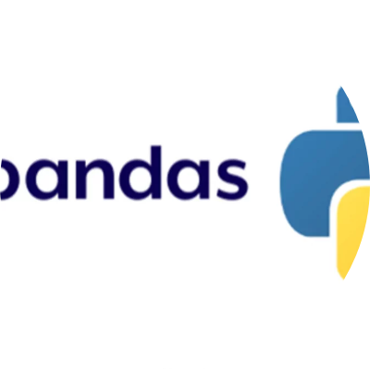
PYTHON TECH STACK
Python Environment: The industry-standard language for its extensive data ecosystem.
Jupyter Notebook: An interactive IDE that allows for "Literate Programming"—combining code, math, and visuals.
Pandas/NumPy - Loading the CSV, handling the TotalCharges string-to-float conversion, and filtering churn segments.
Matplotlib/Seaborn - Generating the fundamental plots, such as histograms for tenure and pie charts for churn distribution.
Scikit-Learn Splitting data, training algorithms, evaluating accuracy and Model training.

Slide 10
PREPROCESSING PIPELINE
Handling Missing Values:
We identify 11 rows where TotalCharges is a blank string.
These are converted to NaN using pd.to_numeric and subsequently dropped, as they represent brand-new customers with zero tenure.
De-duplication
Ensuring unique customer IDs across all merged datasets.
Standardization
Using Standard Scaler to normalize features for model performance.
Outlier Management
Clipping extreme usage values using the Interquartile Range (IQR) method and we are also using boxplot to examine Monthlycharges and Tenure.

Slide 11
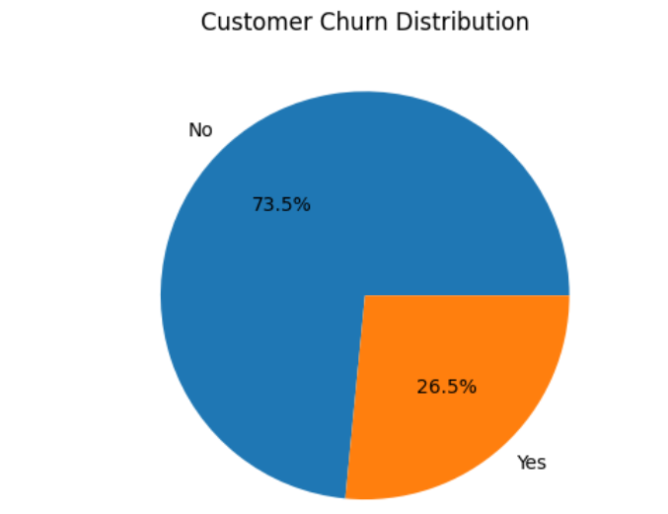
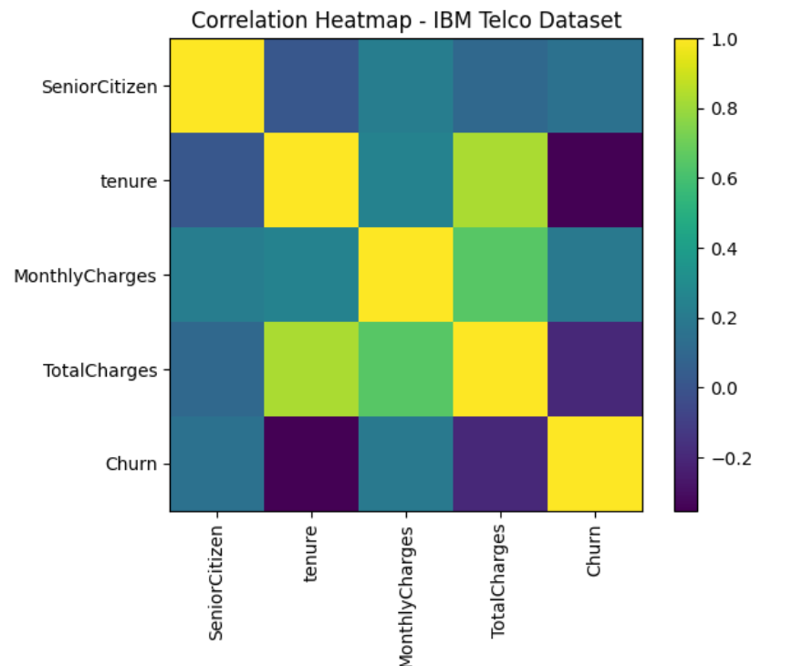
EDA: Exploratory Data Analysis (EDA)

Slide 12
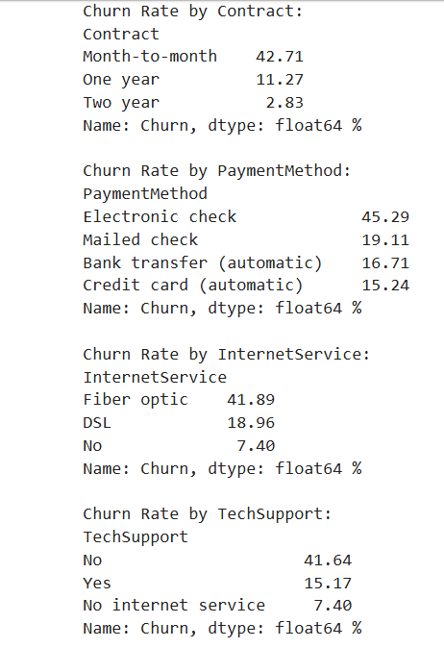
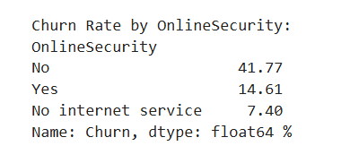
Key churn indicators

Slide 13
Key Insights
1️⃣ High Churn Among Low-Engagement Customers
Customers with low tenure show significantly higher churn rates.
Month-to-month contracts have the highest churn compared to one-year and two-year plans.
Customers without TechSupport or OnlineSecurity are more likely to leave.
Insight: Low engagement, short commitment periods, and lack of service add-ons increase churn risk. Early-stage customers require proactive retention strategies.
2️⃣ Payment Delays Linked to Churn
Customers using Electronic Check payment method show higher churn.
Automatic payment methods (bank transfer, credit card) show lower churn rates.
Insight: Manual or inconsistent payment behavior may indicate dissatisfaction or financial friction, increasing the likelihood of churn.
3️⃣ Service Complaints Strongly Correlated
Customers without support services churn more frequently.
Fiber optic users often show higher churn, possibly due to higher expectations or pricing sensitivity.
Insight: Service quality, technical support availability, and customer experience play a critical role in retention.

Slide 14

RETENTION STRATEGY
Targeted Loyalty Automated discount offers for high-risk segments identified by the model.
Predictive Alerts Flagging customers to support teams as soon as "Low Engagement" patterns emerge.
Contract Migration Incentivizing month-to-month users to shift to annual plans.

Slide 15
Business Impact
Reducing churn by X% directly improves revenue stability and lowers customer acquisition costs. Even a small percentage decrease in churn can significantly increase long-term profitability, as retaining existing customers is more cost-effective than acquiring new ones.
An improvement in retention naturally leads to increased Customer Lifetime Value (CLV). When customers stay longer, their total contribution through subscription renewals, service upgrades, and add-on purchases grows, strengthening overall financial performance.
Proactive churn management also enhances customer satisfaction. By identifying at-risk customers early and addressing service, billing, or engagement issues, organizations build stronger relationships and improve brand trust.
Together, these outcomes create a sustainable competitive advantage. Companies that effectively manage retention not only protect revenue but also differentiate themselves through superior customer experience, data-driven decision-making, and long-term strategic stability.

Slide 16
EXPECTED ROI & OUTCOMES
15%
$2.4M
92%
Churn Reduction
Revenue Saved
Model Accuracy
By implementing these Python-driven insights, the organization moves from descriptive reporting to prescriptive action, gaining a massive competitive edge in market retention.

Slide 17




IMAGE SOURCES
https://d3njjcbhbojbot.cloudfront.net/api/utilities/v1/imageproxy/https://images.ctfassets.net/wp1lcwdav1p1/WLP03Kh71Uik4M1TNEyis/c85e4cfd5cbabbe5137ed86965d83e04/GettyImages-1199128740.jpg?w=1500&h=680&q=60&fit=fill&f=faces&fm=jpg&fl=progressive&auto=format%2Ccompress&dpr=1&w=1000
Source: www.coursera.org
https://www.adobe.com/express/learn/blog/media_14ced3f9ddaa47c60d568eecfc387bc6e4b48ca79.png?width=750&format=png&optimize=medium
Source: www.adobe.com
https://www.guvi.in/blog/wp-content/uploads/2023/10/pandas-logo-65337c3d6c2ed-1-1200x675.webp
Source: www.guvi.in
https://kloudportal.com/wp-content/uploads/2025/01/Loyalty-Programs-That-Drive-Sales-and-Build-Brand-Loyalty.jpg.webp
Source: kloudportal.com

